Slide 1

“Defense Wins Championships”
Sydney Scaccia
Module 8

Slide 2

Motivation
Determine whether defense has an impact on a team’s win percentage throughout the 2019 NCAA Division I football season
Looking at the team’s win percentage which directly correlates to their record

Slide 3

Literature Review
“The most successful teams come from ones that have their top players play a well-rounded game”
(Pierson, 2018)

Slide 4

Literature Review
“Playing with a solid defense on the court increases the team’s win percentage by 2.1 percent as opposed to having a strong offense alone.”
(The Stats Zone, 2016)

Slide 5

Literature Review
Within the past 30 Super Bowls, only 5 games were won with a dominant defense without a dominant offense where 13 games were won with a dominant offense alone.
(‘Defense Wins Chamionships’, 2020)

Slide 6
Hypothesis
The hypothesis under analysis is that defense is the sole factor impacting a team’s win percentage, or the team’s record in this case.

Slide 7
Data Set
131 different Division I football teams
150 different statistics compiled throughout the season

Slide 8
Variables
Dependent Variable = The team’s success, more specifically if the team had a winning season or a losing season
Win Percentage ≥ 50% means a successful season denoted by a “W” or “1”
Win Percentage ≤ 49% means a losing season denoted by a “L” or “0”
Independent Variables = Yards Allowed, Rush Yards, Pass Yards, Points Allowed, Record, Total Points Gained

Slide 9
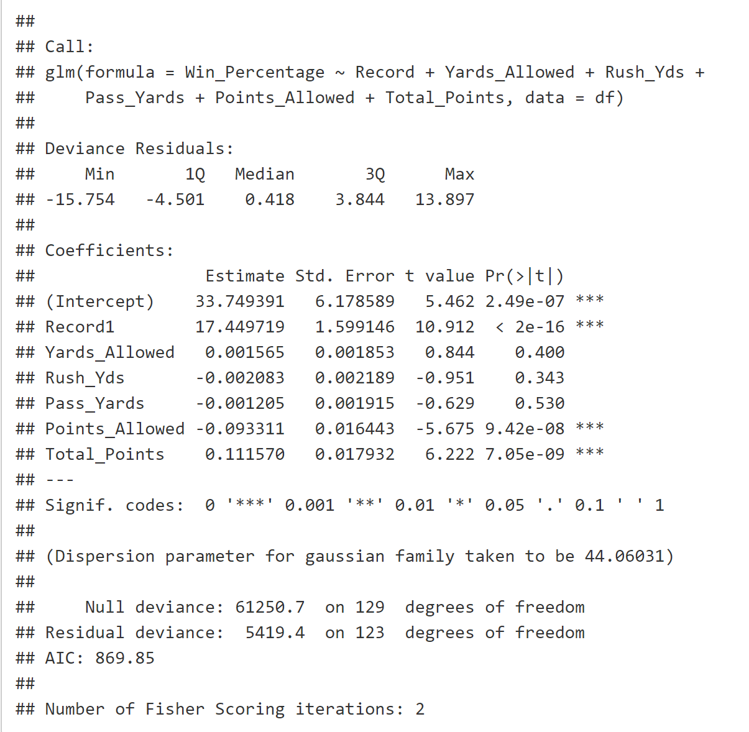
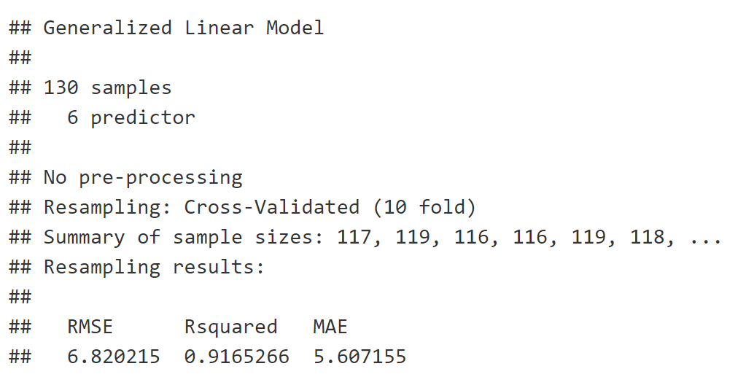
Logistic Regression / Cross Validation Results
Cross Validation
Logistic Regression

Slide 10
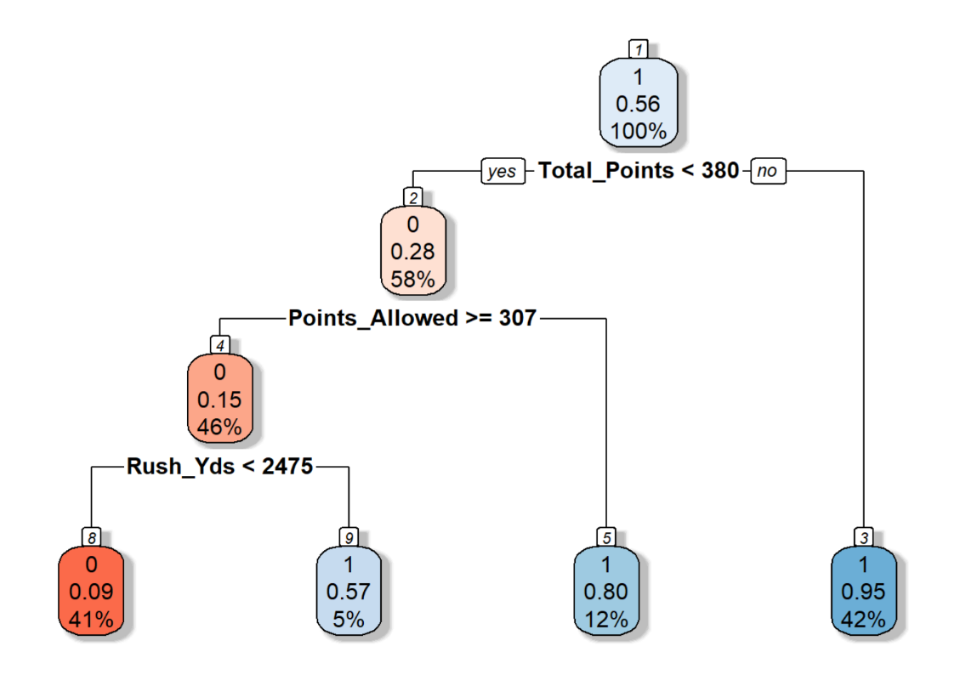
Decision Tree

Slide 11
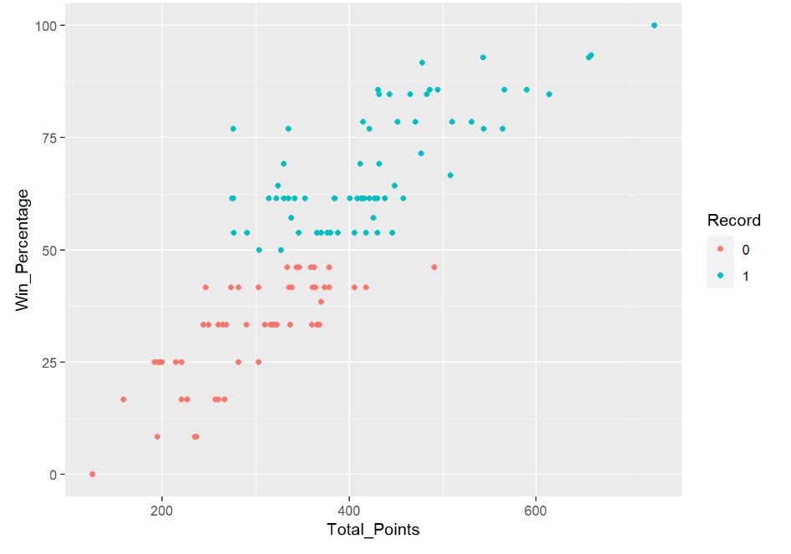
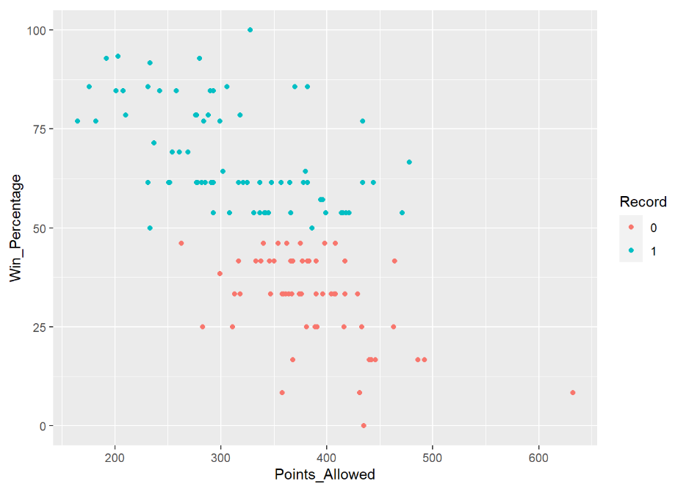

Slide 12

Conclusion

Slide 13
References
'Defense wins championships' myth or fact in the super bowl? (2020, January 27). Retrieved March 10, 2021, from https://www.sportsgamblingpodcast.com/2020/01/22/defense-wins-championships-myth-or-fact-in-the-super-bowl/
Gallini, J. (2020). College football team stats 2019. https://www.kaggle.com/jeffgallini/college-football-team-stats-2019.
Pierson, B. (2018, January). "Defense Wins Championships" Proves True in Hoops. Retrieved September 18, 2020, from https://247sports.com/college/ucla/Article/Defense-Wins-Championships-Proves-True-in-College-Hoops-and-at-UCLA-113782988/
The Stats Zone. Does Defense Win Championships? (2016). https://www.thestatszone.com/archive/does-defence-win-championships-14048.

